Slide 1
AWS Migration Tools, Migration Hub & AWS SMS
Bachelor of Engineering- Computer Science & Engineering
Cloud Computing (CC)(23CS009)
Department of Computer Science & Engineering
Chitkara University Institute of Engineering and Technology, Chitkara University, Punjab, India

Slide 2
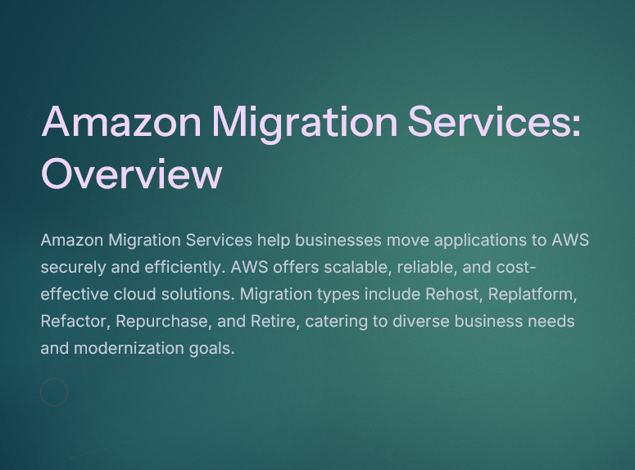
AWS Migration Tools, Migration Hub & AWS SMS
Amazon Migration Services help businesses move their data, applications, and workloads to Amazon Web Services (AWS). These services are especially useful when moving from on-premises infrastructure, private cloud, or another cloud provider (like Azure or GCP) to AWS.

Slide 3
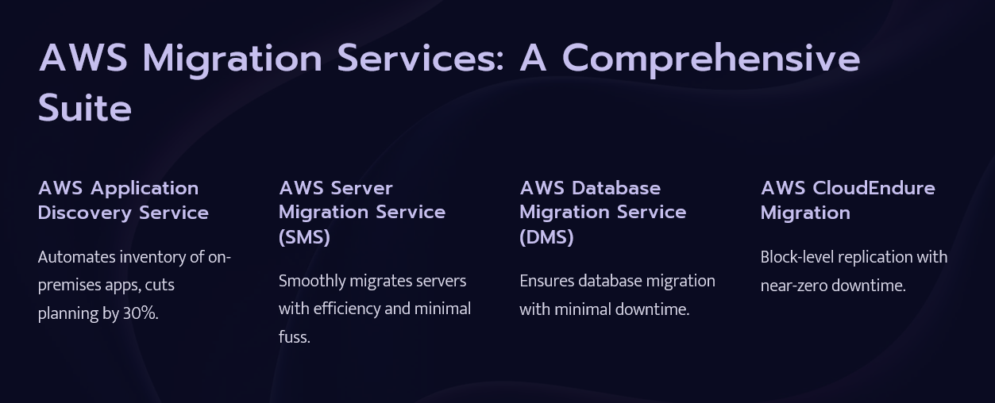
AWS Migration Tools, Migration Hub & AWS SMS

Slide 4
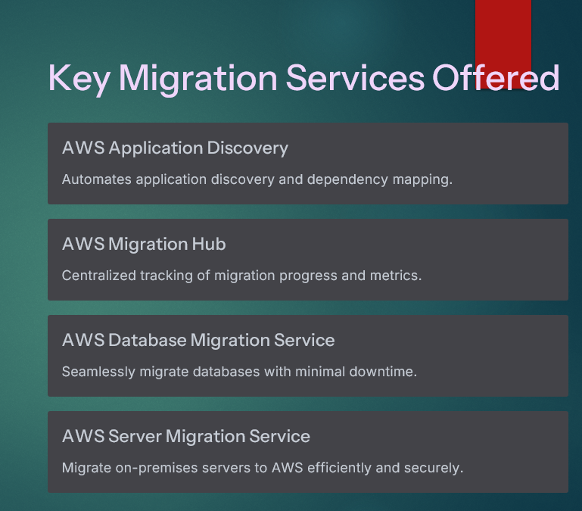
AWS Migration Tools, Migration Hub & AWS SMS

Slide 5
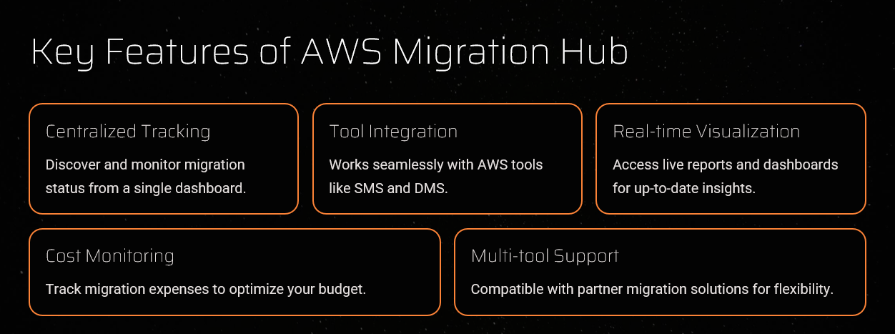
AWS Migration Tools, Migration Hub & AWS SMS

Slide 6
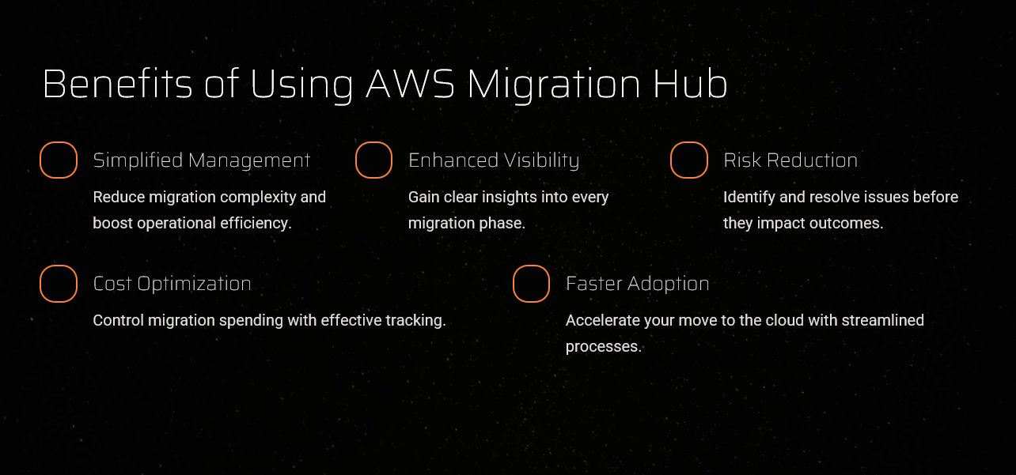
AWS Migration Tools, Migration Hub & AWS SMS

Slide 7
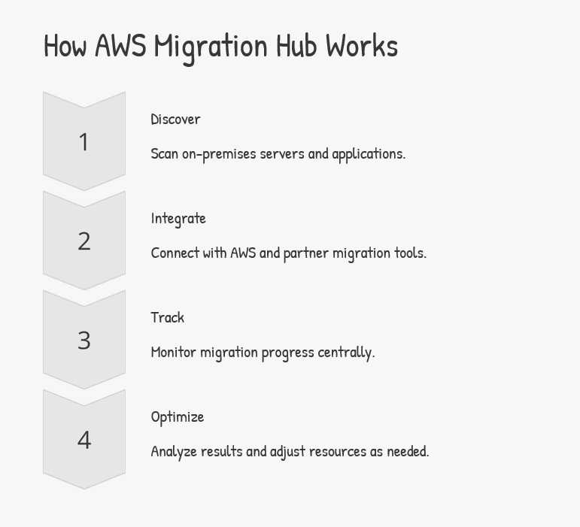
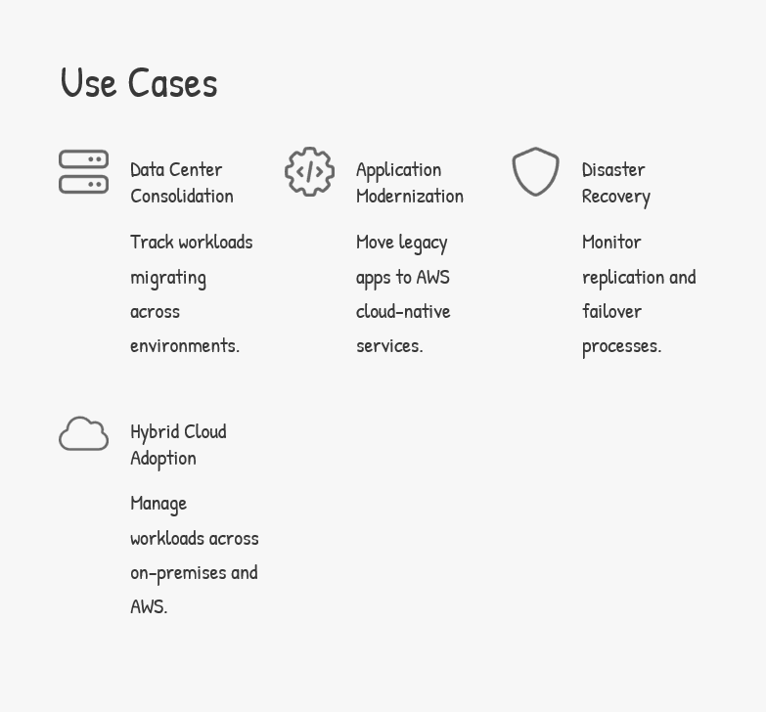
AWS Migration Tools, Migration Hub & AWS SMS

Slide 8
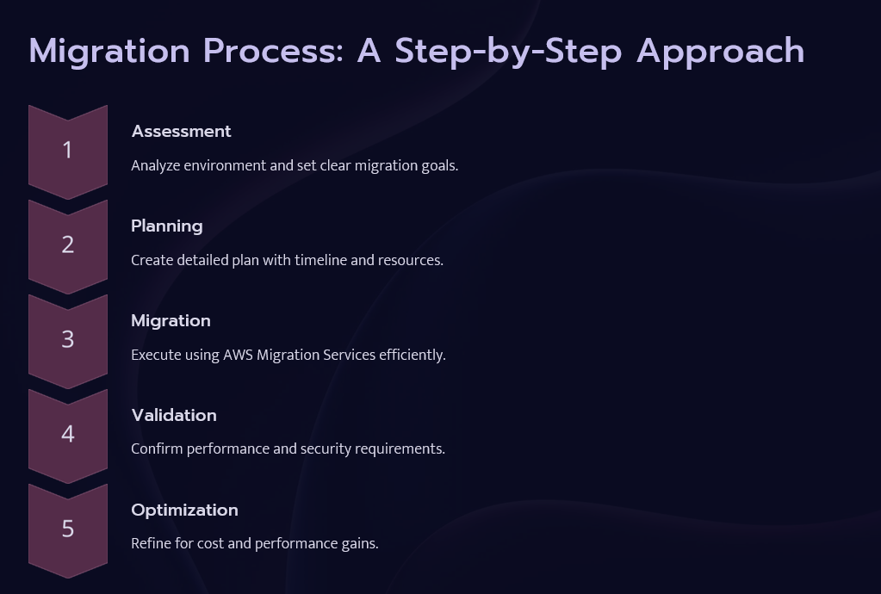
AWS Migration Tools, Migration Hub & AWS SMS

Slide 9
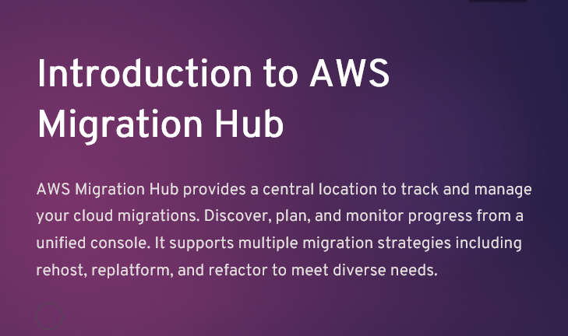
AWS Migration Tools, Migration Hub & AWS SMS

Slide 10
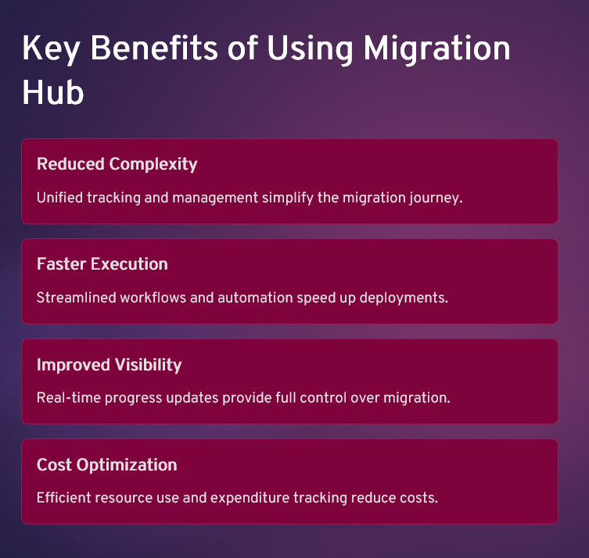
AWS Migration Tools, Migration Hub & AWS SMS

Slide 11
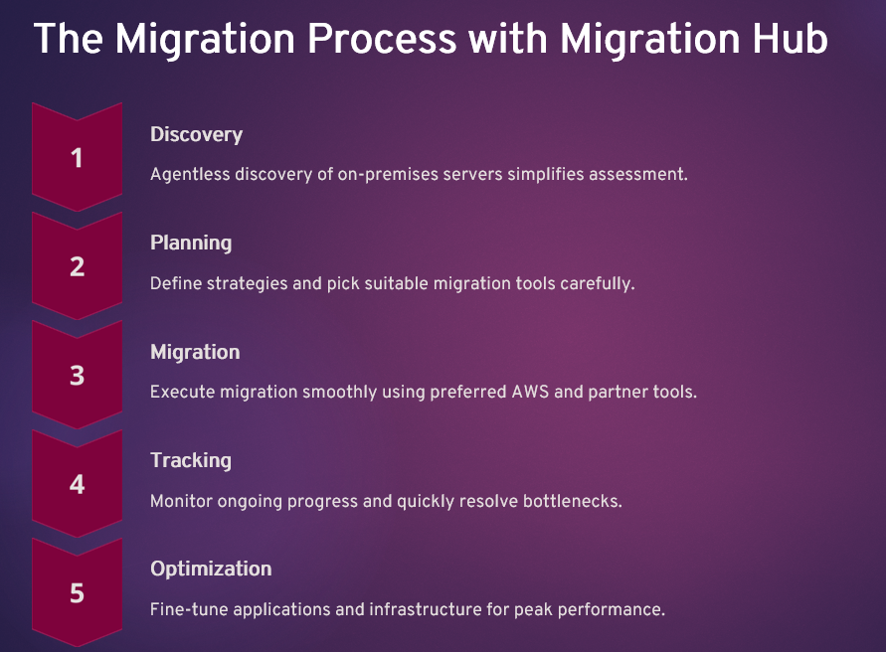
AWS Migration Tools, Migration Hub & AWS SMS

Slide 12
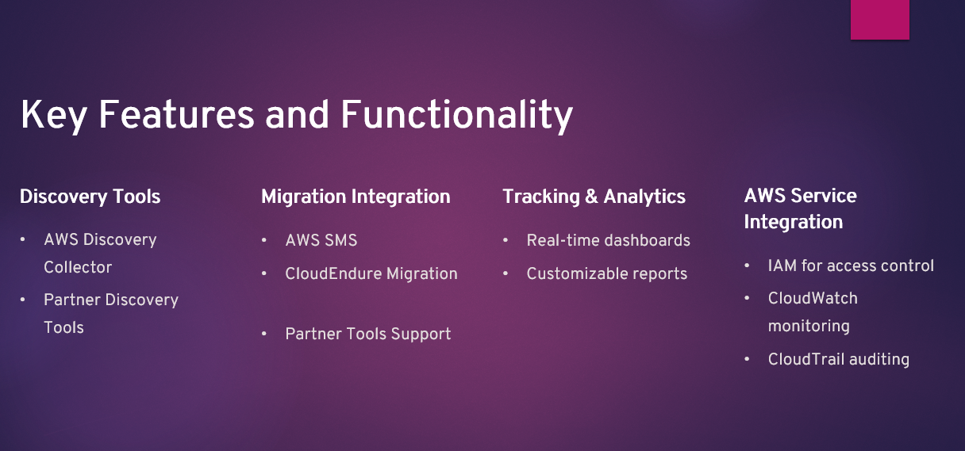
AWS Migration Tools, Migration Hub & AWS SMS

Slide 13
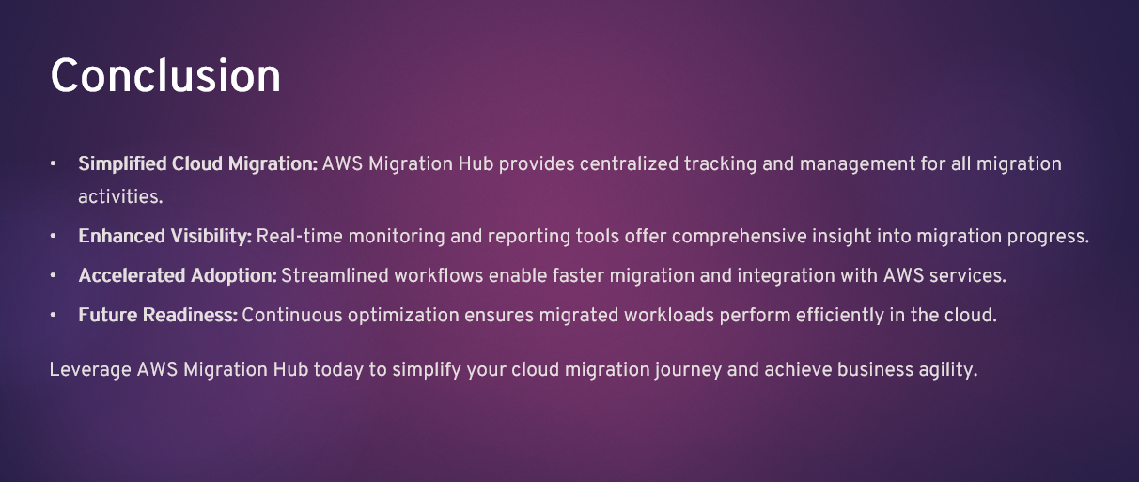
AWS Migration Tools, Migration Hub & AWS SMS

Slide 14


